Slide 1

Carrying Capacity:
Are We Past The Limit?
St. Paul’s Co-educational College, Hong Kong
Yukki He, Justin Lam, Kinsey Yuen, Angel Au
IMMC2019006

Slide 2
Carrying Capacity
K=4.09 billion

Slide 3
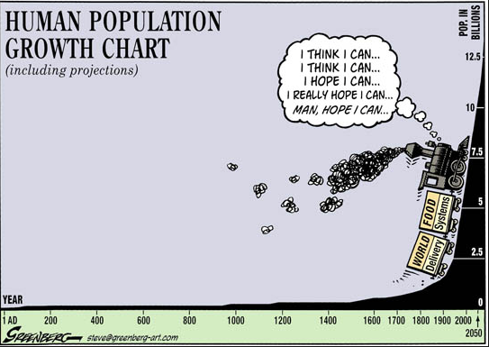
Carrying Capacity
Definition of carrying capacity
Maximum population an environment can sustain indefinitely
Factors affecting carrying capacity
Rate of consumption of resources
Rate of production of resources
Current rate of damage to the environment
Current rate of recovery of the environment

Slide 4
Assumptions
Current conditions and technology do not change
Consumption of resources and carbon emissions are linearly related to the world’s population
Effect of the economy or society are not taken into consideration
Astronomical time spans are not taken into consideration
All the planet’s accessible resources will be used for maintaining humans’ survival.

Slide 5
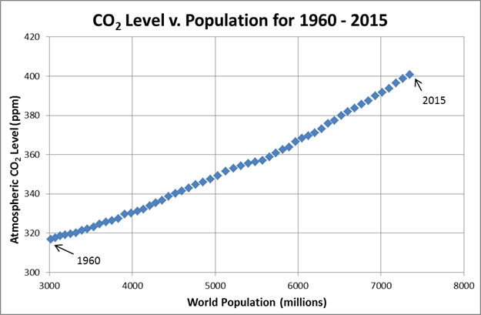
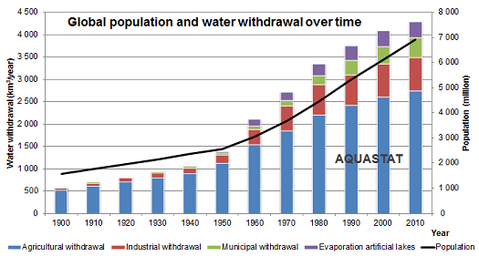
Global population compared with CO2 Level. Note. From “The Correlation between global population and global CO2,” by Graves, R., 2016 (https://wattsupwiththat.com/2016/05/17/the-correlation-between-global-population-and-global-co2/). Copyright 2006-2019 by Anthony Watts. | Global population compared with water withdrawal/consumption. Note. From “AQUASTAT” by Food and Agriculture Organization of the United Nations(FAO), 2016 (http://www.fao.org/nr/water/aquastat/water_use/index.stm). Copyright 2016 by FAO.

Slide 6
Our assumptions
Current conditions and technology do not change
Usage of resources and carbon emissions are linearly related to the world’s population
Effect of the population on the economy or society in the timespan are not taken into consideration
Astronomical time spans are not taken into consideration
All the planet’s accessible resources will be used to support a hypothetical “maximum population”

Slide 7
Crucial Factors

Slide 8
Resources
Related to the availability of resources, consumption and production rates of resources
Dumped factors | Selected Factors
Space | Food
Energy | Water

Slide 9
Damage+Recovery of the planet
Related to the rate of damage to the planet and rate of recovery of the planet
Dumped factors | Selected Factors
Damage of the nitrogen and phosphorus cycles | Carbon emission

Slide 10
Construction of model - Part I: Construction of respective formulas
General formula

Slide 11
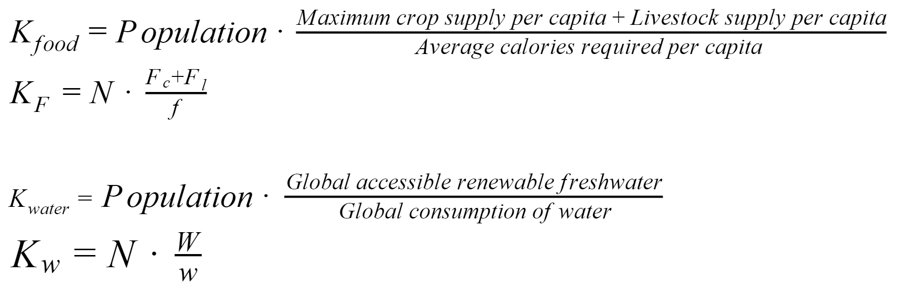
Construction of model - Part I: Construction of respective formulas
Food & Water

Slide 12
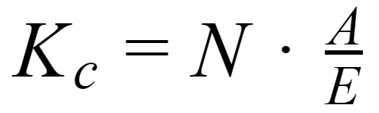
Construction of model - Part I: Construction of respective formulas
Carbon Emission

Slide 13
Construction of model - Part II: Finding suitable data to input into the formulas+Results
Required data
World Population
The world’s consumption or emission of the above factors
The current resources available or the maximum amount the Earth can sustain
Sources of data/information
Food and Agriculture Organization
World Health Organization
Other credible organizations
Papers written by professors/scholars with doctorates

Slide 14
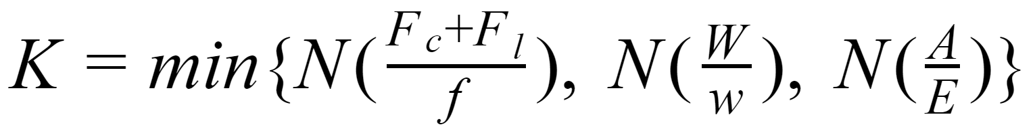
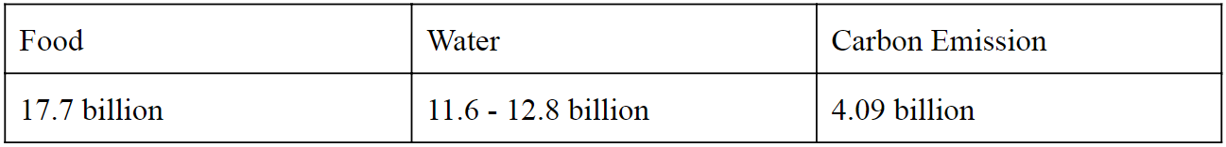
Construction of model - Part II: Finding suitable data to input into the formulas+Results

Slide 15
Construction of model - Part III: Development of an ideal situation
Definition:
Without overconsumption of resources
Equal distribution of resources
No wasted usable resources

Slide 16
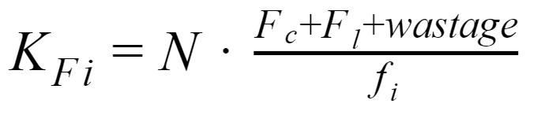
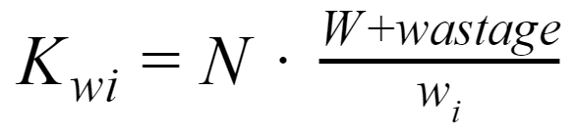
Construction of model - Part III: Development of an ideal situation
Modification of our model:
Consumption adjusted to minimum requirements
None of the resources are wasted

Slide 17
Construction of model - Part III: Development of an ideal situation
Modification of our model:
No data regarding unnecessary carbon emissions
Carrying capacity of carbon emissions remains unchanged

Slide 18
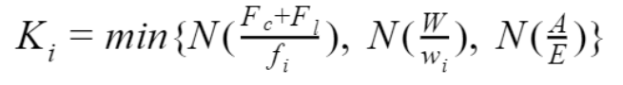
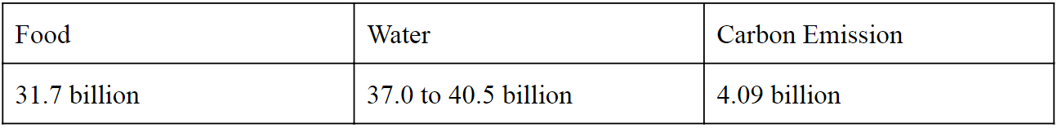
Construction of model - Part III: Development of an ideal situation

Slide 19
Analysis of our model - Strengths
Robust to changes
Comprehensiveness
Convenience & Efficiency

Slide 20
Analysis of our model - Weaknesses
Inaccuracy
Limited consideration of factors

Slide 21
Anticipated Future Conditions
Increased consumption
Rising living standard and quality

Slide 22
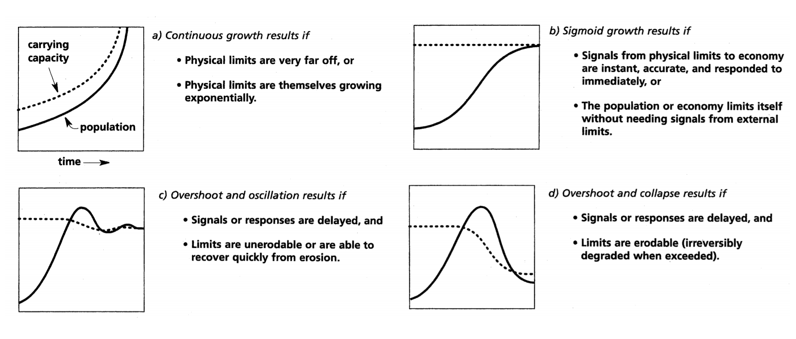
Different scenarios when population reaches carrying capacity.
Note. Reprinted from The Limits to Growth: The 30-Year Update (p. 168), by Meadows, D.H., Meadows, D. L., Randers, J., 2004. White River Junction VT: Chelsea Green Publishing Company. Copyright 2004 by Meadows, D.

Slide 23
Solutions and Suggestions
Carbon Dioxide
Reduce emission
Clean renewable energy
Increase absorption
Afforestation/Planting trees
Synthetic Trees
Other methods to remove carbon

Slide 24
Solutions and Suggestions
Water
Reduce demand
Reducing waste and overconsumption
Increase supply
Desalination
“Mining” of glaciers and ice caps

Slide 25
Solutions and Suggestions
Food
Reduce demand
Reducing waste and overconsumption
Increase supply
Cultivating more land
Countering land degradation
GM food

Slide 26
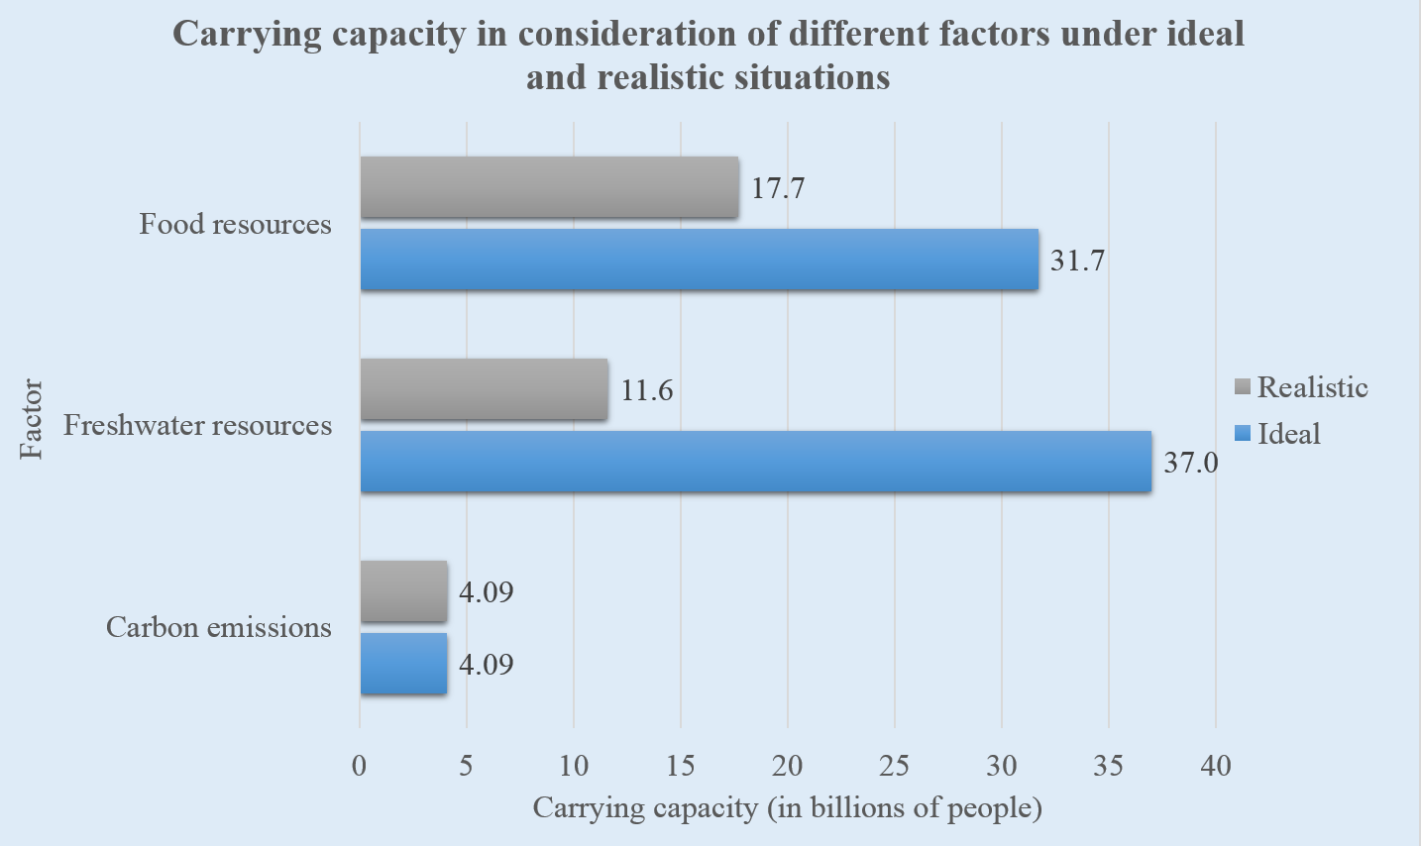
Conclusion

Slide 27
Thank you

Slide 28
Appendix

Slide 29
 | Food | Water | Carbon Emission
Realistic Situation | 17.7 billion | 11.6 - 12.8 billion | 4.09 billion
Ideal Situation | 31.7 billion | 37.0 - 40.5 billion | 4.09 billion

Slide 30

Equations -- Food
In 2013,
2370 kcal/capita/day agricultural products produced and consumed
514 kcal/capita/day livestock produced and consumed
Only 36% of all arable land used for agriculture
7.21 billion population
Assuming all arable land is used for planting crops,
Total food supply = 2370/36%+514 = 7097 kcal/capita/day
By
KF(r)=N*F/f(r)
Carrying capacity based on food
=7.21billion*7097/(2370+514)
=17.7 billion people

Slide 31

Equations -- Water
Accessible renewable freshwater: 12500 cubic km in 1996, 13700 cubic km in 2025(predicted)
In 2014,
3760 cubic km withdrawn
~61% total water supply (2293 cubic km) used for crops, 8% (301 cubic km) for livestock
7.30 billion population
By assuming a linear relationship between water usage and energy produced by crops and that the consumption of water in other sectors remain unchanged,
Total water usage when all arable land is used for planting crops
=2293/36% + 3760*(1-61%) = 7844(?see speaker’s notes) cubic km
By Kw(r)=N*W/w(r),
Carrying capacity based on water = 11.6 to 12.8 billion people
Notes:
2293/36% because we assume linear relationship between the water usage and crop plantation, by 1/36%
BTW LAMMMMMMMMMM WOULD YOU MIND CHECKING THE NUMERICAL VALUE I COULDN’T GET YOUR ANSWER WITH YOUR EQUATION, I ALWAYS GET 7835, I THINK IT’S BECAUSE I USE 1/36% BUT YOU USE 2.78 TIMES CAN YOU FINALISE THAT THANKYOU (PERSONALLY PREFER CHANGING IT INTO MY VALUE OR SIMPLY IGNORE IT NO ONE KNOWS THE VALUE IS WRONG ANYWAY)
I don’t think it really matters, just a rounding error

Slide 32

Equations -- Carbon
In 2014,
26% absorbed by ocean, 30% absorbed by land
7.30 billion population
By Kc=N*A/E,
Kc=N*percentage of carbon absorbed
=4.09 billion people

Slide 33
Solutions -- Carbon
Renewable Energy: Solar, Wind & HEP
5.08 million GWh per year (~3% total electricity consumption)
Strengths and Weaknesses of these renewable energy
Costs
Reliability
Area of land use
However
Takes time for carbon to be absorbed and reach equilibrium → other methods to speed up process
Notes:
Mention why we dont consider nuclear and biofuel
Solar: cheapest, less reliable and occupies least land
Wind: middle, reliable and middle
HEP: most expensive, reliable and occupies most land (but mostly rivers and reservoirs)

Slide 34
Solutions -- Carbon
Afforestation
1 tree absorbs 48 pounds (0.0218 tonnes) per year
9.795 Gigatonnes of carbon dioxide emitted in 2014
7.30 billion population in the same year
By (someone add equation pleaseeeee)
103 trees needed to raise carrying capacity by 1 person
400 billion trees needed to support the entire population
→ infeasible to raise carrying capacity by merely planting trees
→ but it can alleviate the situation
Notes:
Together with developing renewable energy to reduce carbon emission to 0, the carbon dioxide level can reach equilibrium one day (just troll: then what if there is net absorption and one day no more GHG in the atmosphere)

Slide 35
Solutions -- Carbon
Synthetic Trees
~1000 times more effective in taking up carbon than normal trees
40 million trees needed for supporting the population
→ high cost
→ also unable to fully sustain mankind
Turning Carbon Dioxide into Rocks
Strip oxygen ions from carbon dioxide
Mix with water and inject underground\
→ no consistent data
→ still promising solutions that can be considered

Slide 36
Solutions -- Water
Reducing waste by means of drip irrigation and changing behaviour
Agricultural
Recalling figures in the previous sections, in 2014,
6677 cubic km used for agriculture if all arable land is used
~24% of all water used in agriculture (1602 cubic km) lost due to food wastage
6376 cubic km used for irrigation, as 301 cubic km is used for livestock
~50% of water used for irrigation (3339 cubic km) lost due to inefficient methods
Amount of water consumed in 2014 in agricultural sector without any wastage
= 6677-1602-3339 =1736 cubic km

Slide 37
Solutions -- Water
Reducing waste by means of drip irrigation and changing consumption behaviour
Domestic
20L (20e-12 cubic km) as basic human needs for each person per day
Minimum global domestic water use in 2014 = 20e-12*7.30 billion = 0.146 cubic km
Industrial
19.5% total water consumption (734 cubic km) in 2014
Assuming the water consumption in industrial sector remains unchanged,
Total water consumption in 2014= 1736 + 0.146 + 734 = 2470 cubic km

Slide 38
Solutions -- Water
Reducing waste by means of drip irrigation and changing consumption behaviour
7.30 billion population in 2014
By Kw(i) = N*W/w(i)
Carrying capacity based on water when there is no wastage
= 7.30billion*12500/2470 to 7.30billion*13700/2470
=37.0 to 40.5 billion people
Notes:
Think the bracketed (i) can also be omitted

